Slide 1
THE VANGUARD GROUP
Digital Interface Experiment:
A/B Test & Funnel Analysis
Evaluating UI Performance, Client Engagement, and Commercial Viability
DATA ANALYTICS TEAM (Slytherin): Stefano Marchiori, Zahid Wahidi, Sofija Sarafejeva

Slide 2
01 / INTRODUCTION
The Digital Challenge
Business Context
Vanguard aims to provide a seamless, plain-talk digital experience. A modernized onboarding workflow was developed to reduce friction.
The Core Question
Did the new UI lead to higher workflow completion rates?
threshold: 5% increase
The design was tested against this new interface to validate performance and client adoption.
Start
Step 1
Step 2
Step 3
Confirm

Slide 3
02 / DATA ARCHITECTURE
Datasets & Preparation Process
calendar_today
groups
pie_chart
14 Weeks
135,000+
53.4% / 46.6%
Timeframe
March 15 – June 20, 2017
Total Traffic
Total client visits
Group Split
Test: ~30.1k vs. Control: ~26.2k

Slide 4
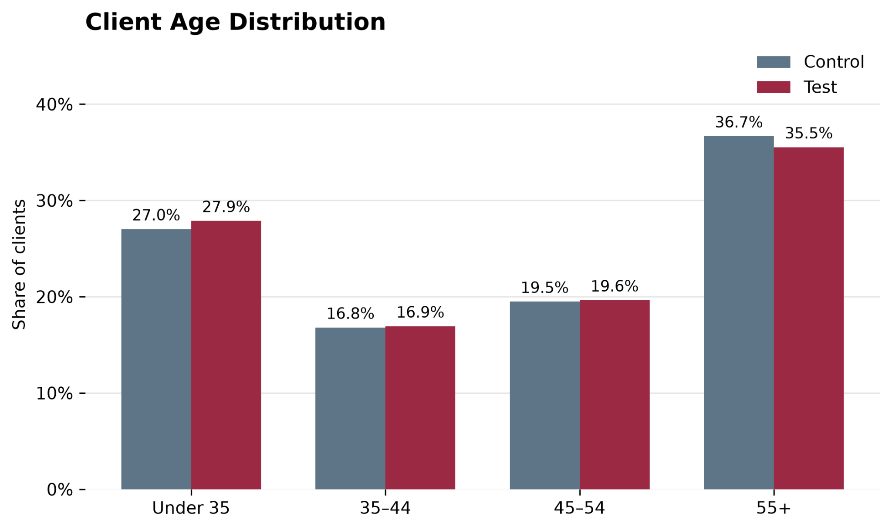
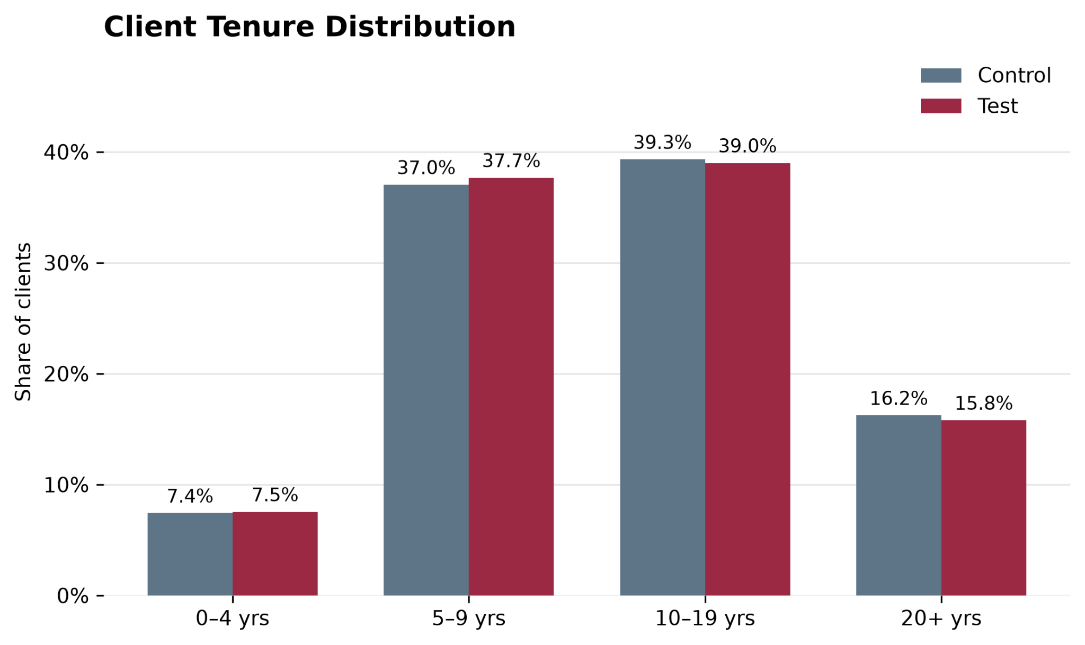
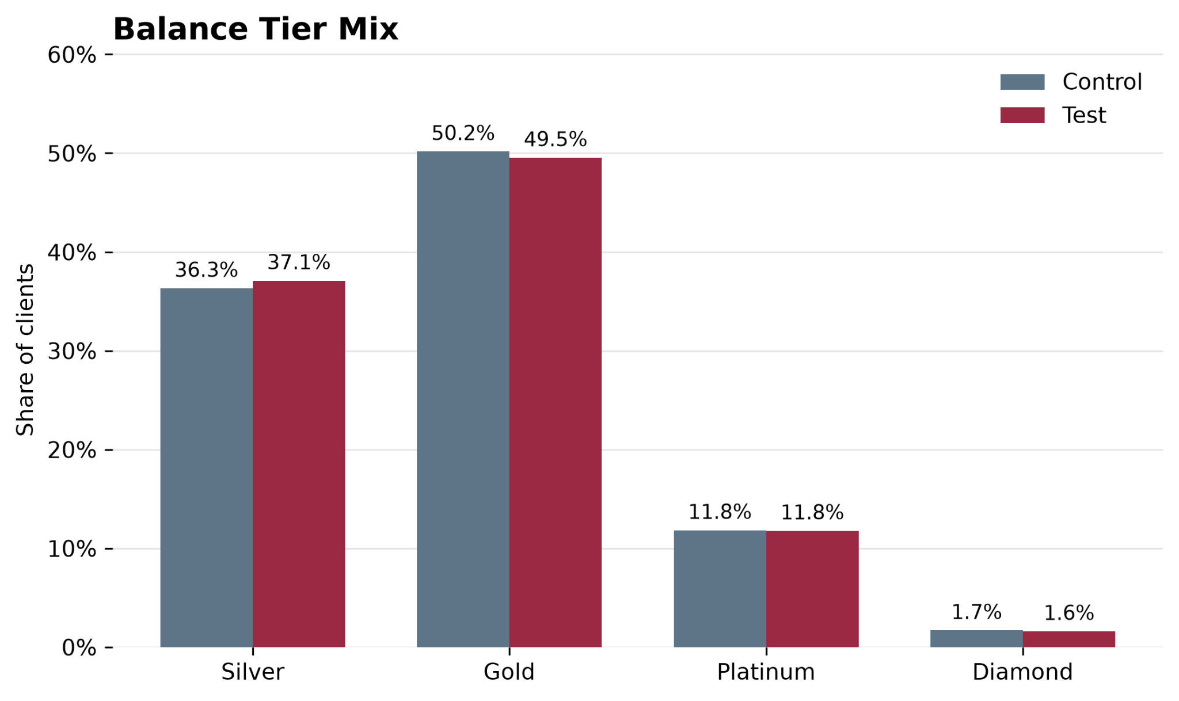
03 / EXPLORATORY DATA ANALYSIS
Client Profile Across the Experiment
Client Age
Client Tenure
Balance Tier Mix
Age distribution across Test and Control clients.
Relationship duration across Test and Control clients.
Client distribution across Vanguard balance tiers.
Source: client profile dataset
4

Slide 5
04 / PERFORMANCE METRICS
Control vs. Test Completion Rate
TEST COMPLETION RATE BASED ON CLIENT ID
HIGHEST TEST COMPLETION RATE: DIAMOND TIER
69.3%
63.3%
+3.7% vs. Control group
+15.3% vs. Control group
TEST COMPLETION RATE BASED ON VISIT ID
TEST COMPLETION RATE: PLATINUM TIER
58.6%
57.9%
+8.7% vs. Control group
+10.2% vs. Control group
This significant lift in completion rates was achieved while adding only 5 seconds to the median visit duration.

Slide 6
05 / HYPOTHESIS TESTING
Statistical Significance Measure
OVERALL COMPLETION RATE
DIAMOND COMPLETION RATE
H0: Test Completion Rate ≤ Control Completion Rate
H1: Test Completion Rate > Control Completion Rate
H0: Diamond Test Completion Rate ≤ Diamond Control Completion Rate
H1: Diamond Test Completion Rate > Diamond Control Completion Rate
p < 0.05
REJECT NULL HYPOTHESIS
p < 0.05
REJECT NULL HYPOTHESIS
Key Takeaway
The new design significantly increased completion rates, successfully passing the 5% business growth target.
p_value = 2.0554e-116
Key Takeaway
High-value clients also saw a confirmed completion lift.
p_value = 1.3310226108574474e-08

Slide 7
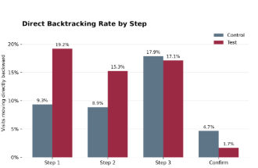
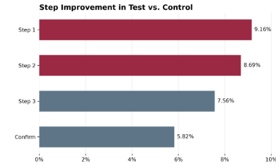
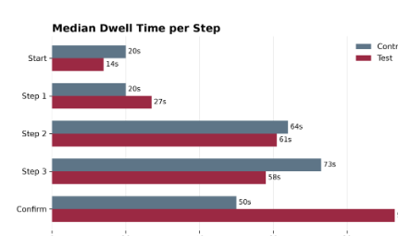
06 / EXPERIMENT EVALUATION
Test Performance: Gains & Friction
Funnel Progression
Time per Step
Direct Backtracking Rate
The Test reaches every funnel milestone at a higher rate.
Time differences vary by step, longer duration does not automatically indicate friction.
Early-stage backtracking is higher in the Test, indicating navigation friction.

Slide 8
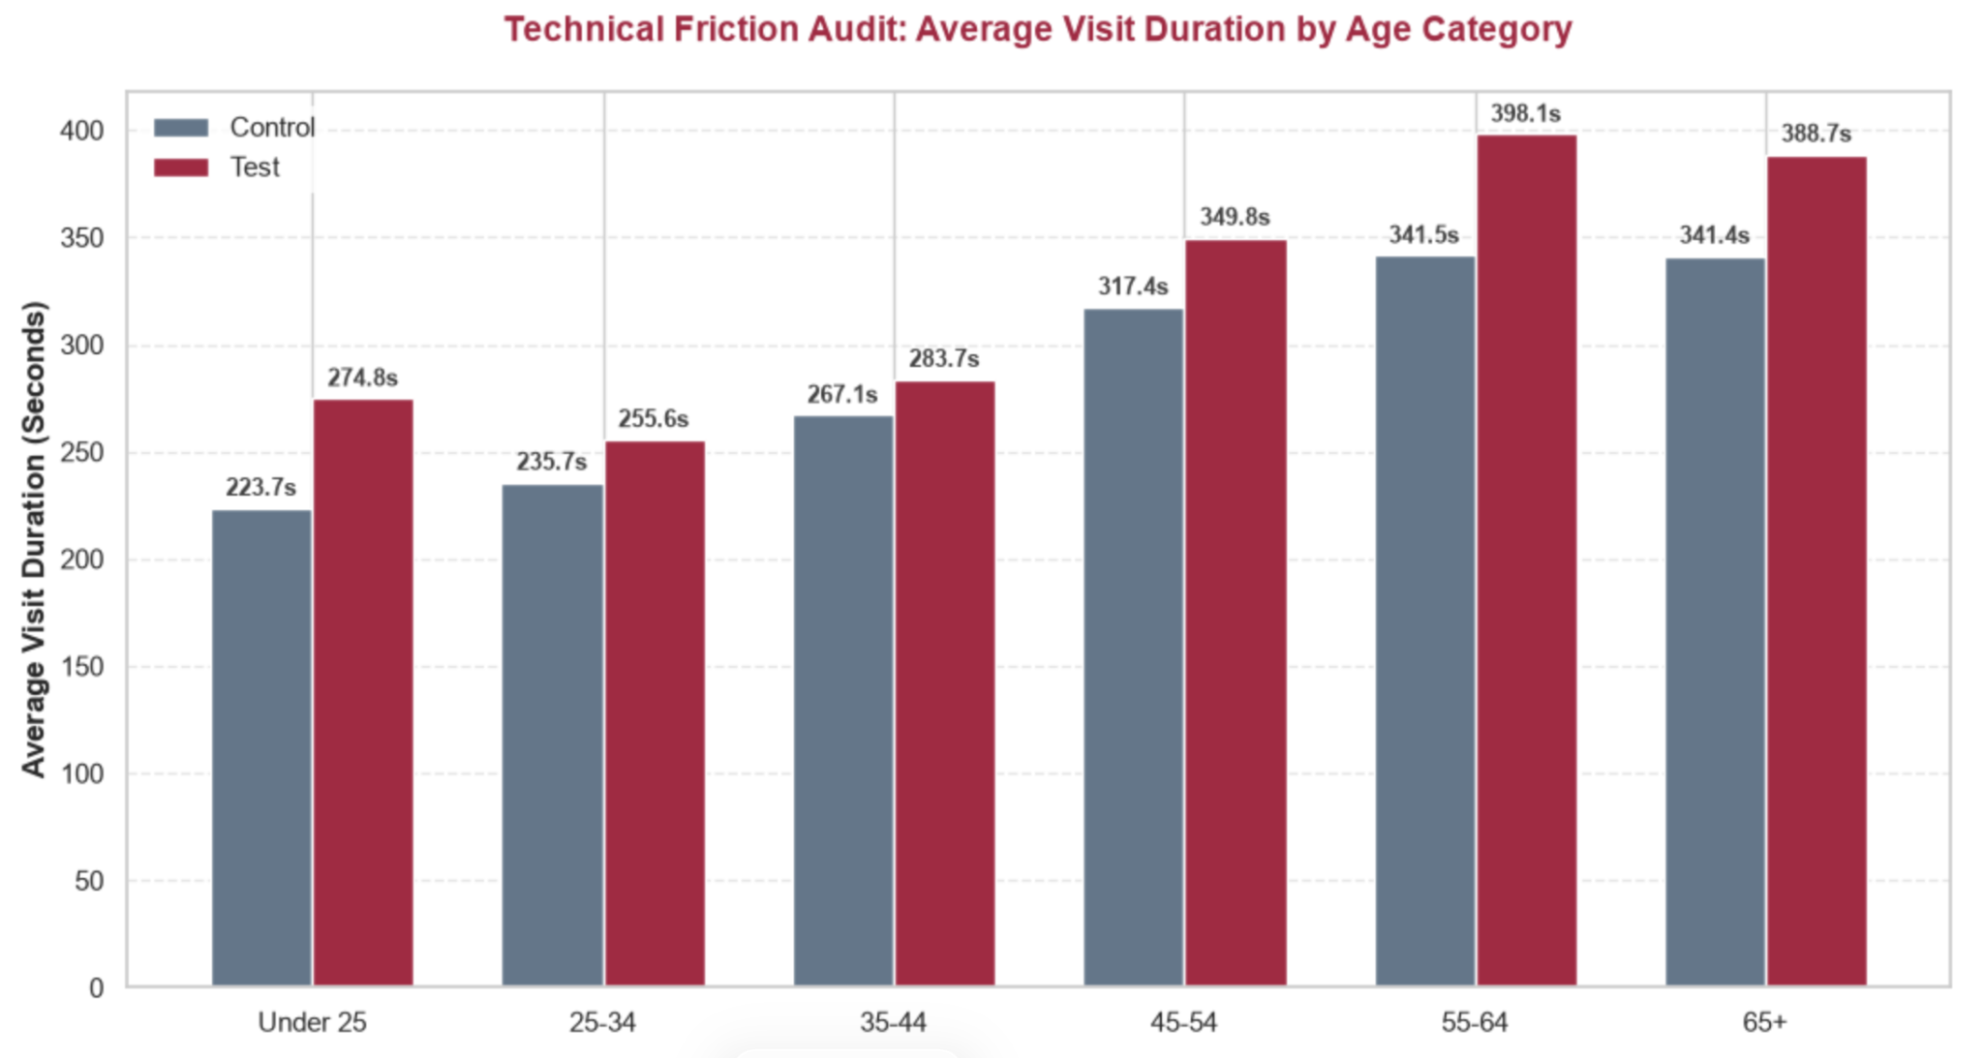
08 / EXPERIMENT EVALUATION
Design Effectiveness & Biases
Uneven Traffic Split
14-Week Duration
Missing Telemetry
53.4% Test vs. 46.6% Control distribution. Requires SRM verification for strict validity.
High statistical power achieved, though timeframe overlapped peak US tax season urgency.
Require device categories and form-level error logs to isolate the Step 3 technical cliff.
Visit IDs
Age and speed
Every page refresh ends up in a new visit ID
Consistent Increase in Friction: Across every single age group, the Test group experienced a higher average visit duration compared to the Control group.
Peak Impact on Older Demographics: The absolute highest visit durations occurred in the 55–64 age category, peaking at 398.1 seconds in the Test variant.
Widest Gap in Youngest Users: The Under 25 demographic showed the largest relative increase, with visit times jumping by 51.1 seconds (from 223.7s to 274.8s) in the Test variant

Slide 10
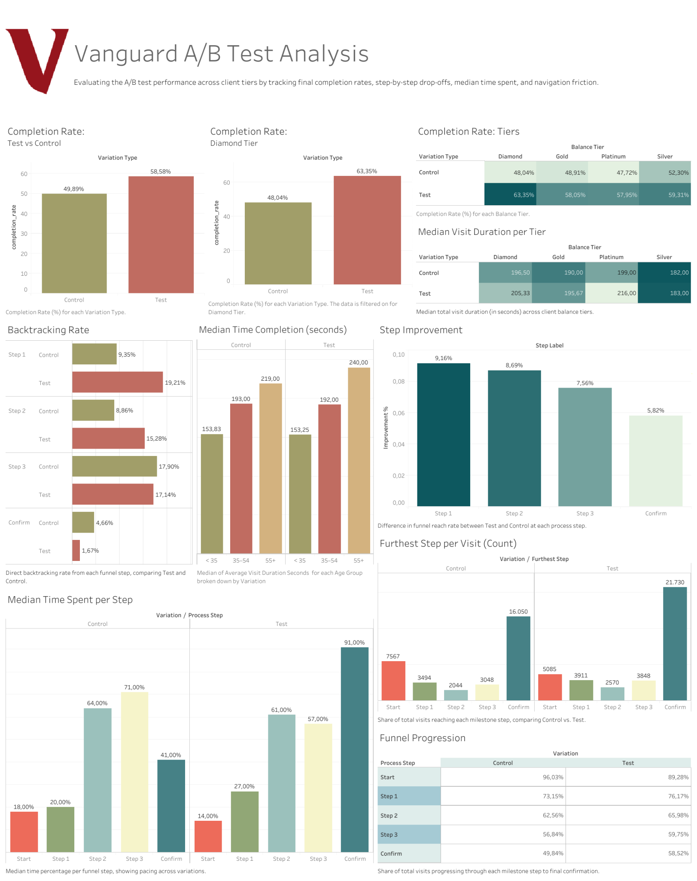
07 / VISUALIZATIONS
Interactive Tableau Dashboard
Executive Dashboard Features
Trace exact step improvement rate.
Tableau Dashboard Demo ]
Side-by-side drop-off comparisons.
Enables fast comparison of Test and Control performance across key user segments.

Slide 11

09 / RETROSPECTIVE
Challenges & Learnings
Major Obstacles
Core Learnings
Data Integrity
Statistical vs. Practical Significance
Fragmented user sessions and untagged variations required rigorous cleaning logic.
A massive p-value does not guarantee commercial deployment viability.
Skewed Outliers
Duration ≠ Friction
Massive session duration outliers necessitated shifting from means to medians.
Longer dwell times indicated careful terms review, leading to higher final conversion.

Slide 12
05 / UX DIAGNOSTICS
User Case Study: Behavioral Anomalies
Tracking edge-case sessions for Client 9988021.
April 12: The "Ghost" Session
April 17: The Friction Loop
0
0
0
+4
0
1
2
3
2
7 consecutive Step 0 hits.
Direct funnel progression attempt.
Exact 16-minute ping intervals.
Blocks at Step 3 validation cliff.
Automated inactive tab heartbeats.
Backtracks to Step 2 and abandons.
Notes:
Client: Gold, Test, 79 Years Old

Slide 13

09 / CONCLUSION
Final Verdict & Recommendations
Approve Full Rollout
Diamond Tier Impact
Fix Step 3 & Step 1
Deploy the Test UI globally. Overall completions surged to 58.58% (+8.69% lift), successfully exceeding the 5% commercial growth target.
Despite minor Step 1 friction and an uneven traffic split, high statistical significance confirms overall deployment viability.
High-value Diamond clients experienced the largest benefit with a massive +15.31% relative lift, driving significant revenue potential.
Prioritize tailored support for Under-35 years old clients (+5.09% lift) while introducing guided tooltips to aid legacy 55+ years old clients.
Focus engineering efforts exclusively on Step 3 form validation errors, which drive 84% abandonment and create severe behavioral friction loops.
Conduct a targeted UX review on Step 1 to reduce backtracking (19.21%) and ensure form-level telemetry logging is enabled.

Slide 14
THE VANGUARD GROUP
Thank You
Q&A Session ?
DATA ANALYTICS TEAM (Slytherin): Stefano Marchiori, Zahid Wahidi, Sofija Sarafejeva

